Slide 1

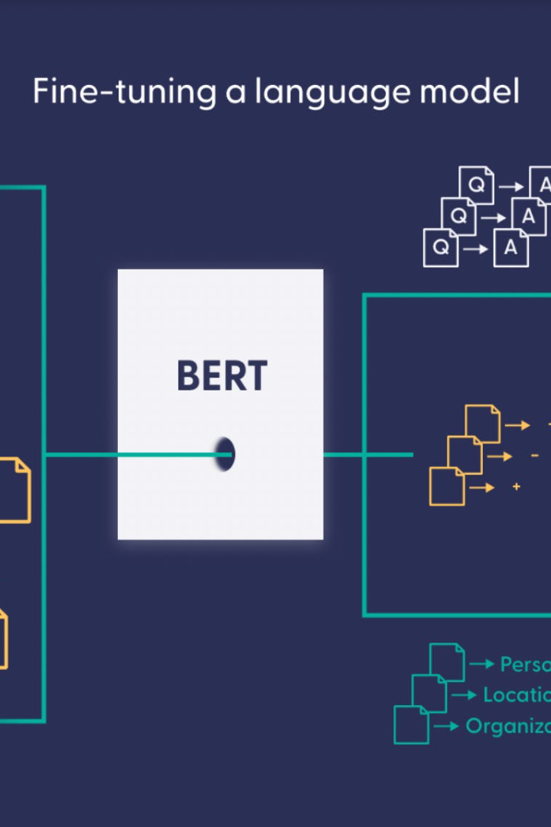

The Power of Language Models
Large Language Models (LLMs) like ChatGPT use machine learning architecture called Transformer to predict the next word in a sentence. They are trained on vast amounts of text data and can generate remarkably coherent responses.
by Dr. Ernesto Lee

Slide 2


Language Learning with LLMs
Efficient Learning 📚
Global Communication 🌏
Cognitive Benefits 🧠
LLMs can summarize and translate texts, enabling faster learning for students.
LLMs can translate between various languages, enhancing cross-cultural communication and understanding.
Bilingualism promotes brain flexibility, increasing cognitive abilities, and LLMs can ease the process of language learning.

Slide 3

Limitations of LLMs
1
Contextual Disadvantage 🤔
2
Biased Outcomes 🙄
LLMs can perpetuate explicit and implicit biases present in the data they were trained on, contributing to societal inequalities.
LLMs lack context awareness and can give flawed responses based on irrelevant data.
3
Lack of Originality 🤔
LLMs cannot create entirely new text as they rely on pre-existing patterns, which can limit creative potential.

Slide 4
Applications of LLMs
1
2
3
Questions & Answers 🤖
Content Creation ✍️
Business Success 💼
LLMs can provide accurate and helpful information in response to questions in multiple domains.
LLMs can generate creative content like blogs, stories, and poems, which can inspire and entertain audiences.
LLMs can analyze customer feedback, generate product descriptions, and perform sentiment analysis, enhancing marketing capabilities and driving sales.

Slide 5

ChatGPT: Your AI Interlocutor
ChatGPT is an AI chatbot that uses reinforcement learning to hold a fluent and coherent conversation with you. It is continually learning and improving, making it ideal for support, education, or entertainment. Remember to use it appropriately!

Slide 6
Future of LLMs
Unsupervised Learning 🤖
Generalization 🔍
LLMs can learn without explicit instructions, resulting in a more comprehensive understanding of language.
LLMs are expanding their capabilities outside of language applications, with many possible future uses like music, art, and gaming.

Slide 7

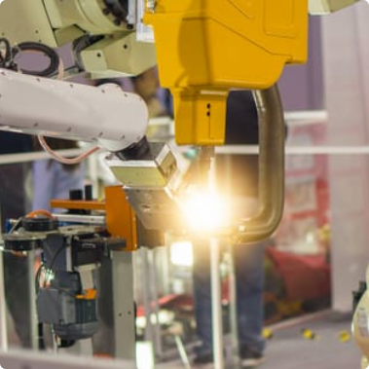
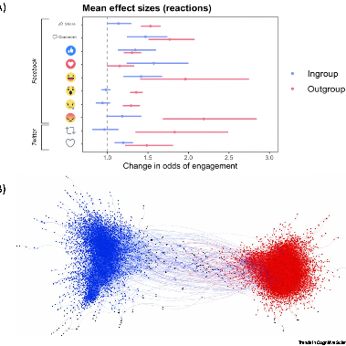
Risks to LLMs
Security Threats 🔒
Workforce Changes 🤖
Socio-political Effects 🌊
LLMs could be exploited to generate convincing but fake content, posing a risk to security and privacy.
LLMs could replace human writers, posing a threat to traditional forms of employment.
LLMs could contribute to the spread of fake news, propaganda, and polarization, leading to damaging societal effects.

Slide 8
Responsible Use of LLMs
1.
Eliminate biased data and promote diversity in data sources
2.
Use LLM-generated content with caution, verifying accuracy with external sources
3.
Ensure transparency and accountability in the development and deployment of LLMs
4.
Focus on collaborative efforts between humans and LLMs, in domains like education and healthcare

Slide 9

The AI Startup Playbook
Learn the fundamental steps to build a successful AI startup from identifying a niche problem to scaling up your product.
by Dr. Ernesto Lee

Slide 10
Find a Specific Niche Problem
Be Specific 🔍
Choose a niche one level further than what others are doing successfully.
1
2
3
Research the Market 🤔
Example: Automatic Food Video Generator 🎥
Look for gaps in the market where few companies address.
Create a system that auto-generates YouTube videos within the food industry.

Slide 11
Capture Unique Data
Data Collection 🔍
Example: Speech-to-Text Tool 🎙️
First Data Set 👨‍💼
Capture unique data that nobody else has.
Create a first rough data set in a folder with spreadsheets or a database.
Use Python code to extract captions from the 100 most popular YouTube food videos.

Slide 12
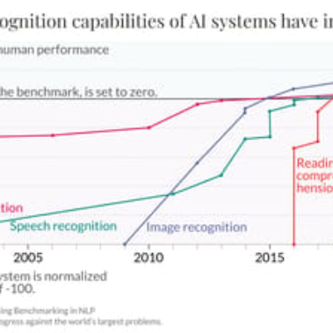
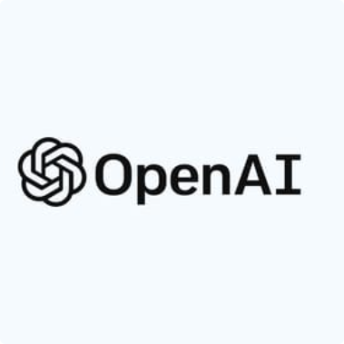

Train a Superior AI Model
Improve Continuously 🎓
Use AI Resources 🤖
Create Valuable Insights 💡
Train a model that performs better and better.
Utilize resources like OpenAI API algorithms to extract value from your data.
Run complex Python code that fine-tunes and refines results.

Slide 13
Polish the User Interface
1
Make it Simple 🧐
Ensure your user interface is simple and intuitive to enable seamless interaction and user engagement.
Prioritize the User 🙌
2
Consider the user journey and how you can make it as frictionless as possible to drive adoption.
3
Maximize the UX 👨‍💻
Ensure a seamless UX from end to end to make your product stand out in the market.

Slide 14
Implement a Subscription Model
Reasonable Pricing Strategy 💰
Sell the Value 🤝
Example: Video Creation App 🎬
Create a marketing message to emphasize the value of using your product.
Set a reasonable monthly fee for your product.
Charge $99 monthly to create up to 99 videos. Marketing message: "_$1 per food video!_".

Slide 15



Acquire Your First Customers
Share on Reddit 🚀
Facebook Groups 👥
Launch Paid Ads 💰
Share your AI company URL on Reddit or other online platforms.
Join relevant Facebook groups and share your product with potential customers.
Allocate some budget to acquire your first few customers with strategic ads.

Slide 16

Constantly Improve Your Product
1
Talk to Your Customers 📞
2
Email Marketing 📧
3
Focus on Product-Market Fit 🎯
Leverage email marketing to communicate product updates and gather customer feedback.
Connect with them to gather feedback and suggestions on how to improve your product.
Continuously improve and pivot your product to achieve the perfect product-market fit.

Slide 17
Scaling Up Your Business
Online Advertising 📈
Partnerships 🤝
Expand into Related Niches 🌟
Use online advertising to reach new customers and connect with relevant audiences.
Collaborate with partners to reach new audiences and offer co-branded products and services.
Create new products or services that leverage your existing AI expertise in related niches.
Google Ads
YouTube Influencers
Facebook Ads
Food Blogs & Magazines
Recipe Builder
LinkedIn Ads
Nutritionist & Personal Trainers
Online Cooking Classes
Food Delivery Service

